Slide 1
Facilities & Administration Costs
& Service Centers
Presented by:
Doug Backman , Director
Mary Stanley, Assistant Director

Slide 2
Agenda
Introduction & General Overview
F&A Definition and Category Application
Application of F&A Cost Rates
The Distribution Basis
Closing Remarks

Slide 3
Introduction & General Overview
F&A Costs – General overview and impact
Cost recovery
Support university operations
General Definition:
F&A Costs are those that are incurred for common or joint objectives and therefore cannot be identified readily and specifically with a particular sponsored project, an instructional activity, or any other institutional activity.

Slide 4
F&A Definition and Category Application
F&A costs are broad categories of costs.
“Facilities” is defined as depreciation and use allowance, interest on debt associated with buildings, equipment and capital improvements, operation and maintenance expenses, and library expenses.
“Administration” is defined as general administration and general expenses, departmental administration, sponsored projects administration, student administration and services.

Slide 5
F&A Definition and Category Application
Depreciation and use allowances
Portion of cost attributable to institution’s buildings, capital improvements to land, buildings, and equipment.
Cost is prorated based on space use (sq.ft. - laboratories, offices etc.) by employees (FTE) benefiting from such use.
Includes parking, sidewalks and fencing

Slide 6
F&A Definition and Category Application
Operation & Maintenance Expenses
Expenses include administration, supervision, operation, maintenance, preservation and protection of the institution’s physical plant.
Janitorial & utility services
Building repairs and alterations
Furniture & equipment
Care of grounds
Maintenance and operation of buildings
Security, EH&S, waste disposal
Liability insurance

Slide 7
F&A Definition and Category Application
General Administration and General Expenses
Costs incurred by the executive and administration offices of educational institutions and other expenses of a general character which do not relate solely to any major function of the institution.
Costs that serve entire university system
President and Provost offices
Financial, Budget and IT management
Business services
Human Resources
Safety & Risk management
General Counsel

Slide 8
F&A Definition and Category Application
Departmental Administration Expenses
Administrative and supporting services that benefit common or joint departmental activities or objectives in academic deans’ offices, academic departments and divisions, and organized research units (research centers).
Academic Deans’ offices - expense limited to salary & administrative functions
Academic Departments – salaries & fringe related to administrative work (including bid & proposal preparation) shall be allowed at a rate of 3.6% of MTDC

Slide 9
F&A Definition and Category Application
Departmental Administrative Expenses Cont.:
Administrative and supporting costs must be treated consistently in like circumstances to include salaries of secretarial and clerical staffs, travel, office supplies, stockrooms, and the like.
Departmental administrative costs incurred for the same purpose in like circumstances must be treated consistently as either direct or F&A costs.
Salaries of administrative and clerical staff should normally be treated as F&A costs.

Slide 10
F&A Definition and Category Application
Departmental Administration Expenses Cont.:
Direct charging of departmental administration and clerical staff may be appropriate where a “major project” or activity explicitly budgets for administrative or clerical services and individuals can be specifically identified with the project or activity.
“Major Project” is defined as a project that requires an extensive amount of administrative or clerical support, which is significantly greater than the routine level of such services provided be academic departments.

Slide 11
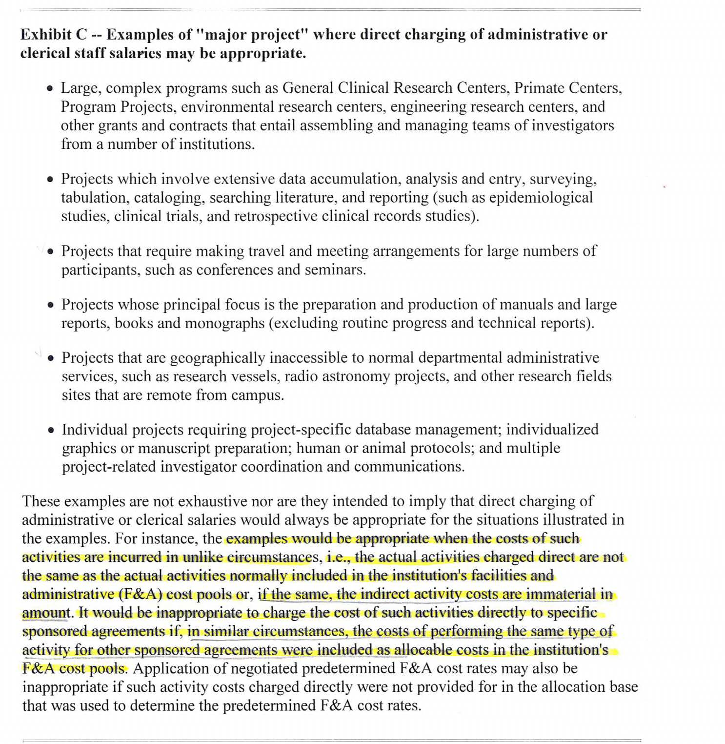
F&A Definition and Category Application
Departmental Administrative Expenses Cont.:
OMB Circular A-21, Exhibit C Examples:

Slide 12
F&A Definition and Category Application
Sponsored Projects Administration
Costs are limited to the institution’s organization that administers sponsored projects that include:
Grant & contract administration
Purchasing, security, and Finance & Admin.
Editing and publishing reports
Administrative and staff costs and other support personnel
General administration and general expenses
Operation, equipment and maintenance expenses

Slide 13
F&A Definition and Category Application
Library Expenses
This heading covers operational cost of the library to include: books and library material, general administration and general expenses, salaries & fringe, support activities, operation and maintenance, and depreciation use allowances.
Expenses shall be allocated on the basis of primary categories of users, including students, professional employees and other users.

Slide 14
F&A Definition and Category Application
Student Administration & Services
This heading includes incurred costs for the administration of student affairs and for services to students, including expenses for the dean of students, admissions, registrar, counseling and placement services, student advisors, student health and infirmary services, catalogs, and commencement and convocations.
Includes academic staff that benefit sponsored projects on a prorated basis.
Includes a share of general administration, operation, maintenance and use allowance.

Slide 15
Application of F&A Cost Rates
Criteria for Distribution
The overall objective of the F&A cost allocation process is to distribute the F&A costs to the “major functions”:
Sponsored projects
Instructional activities
Other institutional activity
F&A costs are pooled in each F&A category and are assigned to each major function

Slide 16
Application of F&A Cost Rates
Criteria for Distribution Cont.:
F&A costs are allocated to each major function or pool. The amount of costs in each pool (or major function) is divided by the distribution base (total sponsored funding) to arrive at a single cost rate for each major function.
Sponsored project function = Major function %
Total sponsored funding
$46 Million/$100 million = 46%

Slide 17
Application of F&A Cost Rates
The Distribution Basis
F&A costs shall be distributed to sponsored agreements within each “major function” on the basis of modified total direct costs (MTDC).
Salaries, wages, fringe benefits
materials and supplies
Services and travel
Sub agreements up to the first $25K
Equipment, capital expenditures, patient care, tuition remission, rental costs, scholarships & fellowships are excluded

Slide 18
Application of F&A Cost Rates
The Distribution Basis – F&A Rate Types
Predetermined Rates
F&A rates established through the institutions cognizant audit agency.
Provisional Rates
Appropriate when the cognizant agency determines the facts do not justify the rates or if the parties cannot agree on an equitable rate. Applies during F&A Rate agreement extension periods.

Slide 19
Application of F&A Cost Rates
The Distribution Basis
Fixed Rates for Life
Federal agencies shall use the negotiated F&A Rates in effect at the time of the initial award throughout the life of the sponsored agreement. “Life” means each competitive segment of a project as defined under each award.
When an institution does not have a formal negotiated rate at the time of award, then the provisional rate shall be used.

Slide 20
QUESTIONS or COMMENTS?
Doug Backman
dbackman@ucf.edu
407-882-1168
Mary Stanley
Mary.Stanley@ucf.edu
407-823-2836

Slide 21
THANKS FOR JOINING US!
See you at the next session:
Award Close-outs
October 9, 2013
9:00 am to 11:00 am
ORC 2nd floor large (#211)

